Slide 1
Explainable Credit Decisions with Tabular Foundation Models
Conformal deferral, real-time Shapley explanations and explanation stability
Niveditha Venkatesh · 24BLC1039 · SENSE, VIT Chennai
Notes:
Title slide. This is Paper 2: it rebuilds the credit system from Paper 1 on a new kind of model, a tabular foundation model, and studies what that changes for explanation and for sending decisions to a human.

Slide 2
From Paper 1 to Paper 2: what changed
Paper 1 (earlier work)
Paper 2 (this work)
Random Forest trained on the data
Tree SHAP explanations
Fixed rule: defer if 0.46 ≤ P(bad) ≤ 0.54
Hand-picked SHAP threshold (0.05)
One 80/20 split, ROC-AUC 0.807
Foundation models (TabICLv2, TabPFN): no training
Shapley values by re-contextualising the model
Conformal prediction decides when to defer
Thresholds learned on calibration data
New gate: are the rejection reasons stable?
10 splits + significance tests
Weak point: a standard model and hand-picked rules, so little novelty.
Notes:
Paper 1 showed the idea of using explanations as live control signals, but the model and thresholds were standard. Paper 2 keeps the three-tier idea and changes the model, the deferral rule, and adds a new stability check.

Slide 3
Four research questions
1
Accuracy
2
Deferral
Do foundation models beat tuned tree models on small credit data?
Is conformal deferral better than a fixed window, and is it fair across groups?
Answered (E1)
Answered (E2, E3)
3
Real-time explanation
4
Stability (headline)
How much explanation accuracy do we lose to make it fast?
If the past applicants change, do the rejection reasons change?
Answered (E4)
Answered (E5, E6)
Notes:
These four questions organise the whole paper. All four now have results, and E6 tests the complete system.

Slide 4
The basics
01
What a tabular foundation model is, and the data we use

Slide 5
What is a tabular foundation model?
Classical model (Random Forest)
Tabular foundation model (TabPFN, TabICL)
Training data
Pre-trained once on millions of fake tables
Train for minutes, tune settings
Give it the context set (600 past applicants)
Fixed model
One forward pass, no training
Predict new applicant
P(bad) for the new applicant
Key idea: the model learns "in context", like reading examples before answering. Its answer depends on which past applicants are in the context set. That is why we must check whether its explanations stay stable when the context set changes (RQ4).
Notes:
A Random Forest is trained on the data. A foundation model was trained once, long ago, on millions of synthetic tables. To predict, we just show it our past applicants and the new one, and it answers in one pass. Because the answer depends on the context set, explanations could change when the context set changes.

Slide 6
The data: corrected South German Credit (UCI 573)
1,000
20
30%
10
applicants
features
bad (defaulted)
random splits
Each split (same files for every model)
Context set
60% · 600
Calibration
20% · 200
Test
20% · 200
the model learns from these
sets thresholds (α, θ, τ)
final scores, never used for tuning
Why the corrected version? The old Statlog file codes sex and foreign-worker status wrongly. Protected attributes: age, personal status/sex, foreign worker. Sex cannot be fully recovered (one code mixes "male single" and "female non-single"), so fairness is studied by age band (150 under 25 / 850 aged 25+) and foreign worker (only 37 people).
Notes:
We use the corrected South German Credit data. Every split keeps the 70:30 good-to-bad ratio. The context set is what the foundation model reads; the calibration set is only used to set thresholds; the test set is only used for final scores. That prevents cheating by tuning on the test set.

Slide 7
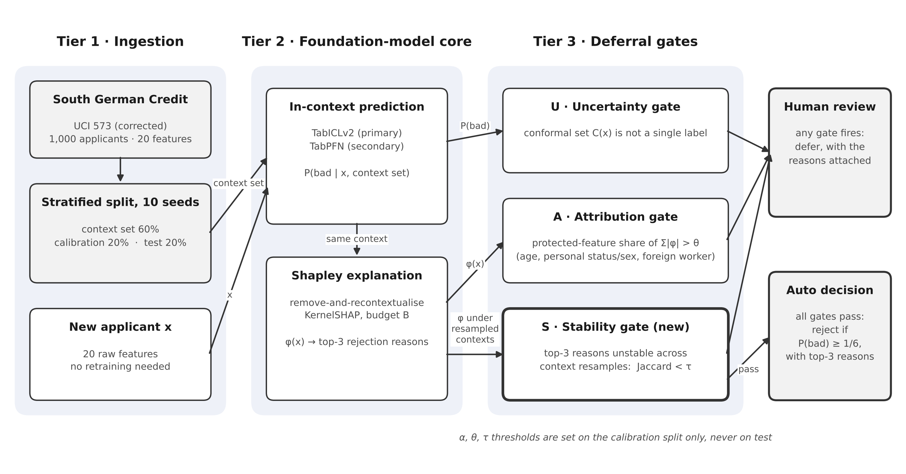
System architecture: three tiers, three gates
Tier 1 prepares the data, Tier 2 predicts and explains, Tier 3 decides: if any gate fires, a human reviews the case.
Notes:
Tier 1 loads and splits the data. Tier 2 is the foundation model, which gives the probability of default and the Shapley explanation. Tier 3 has three gates: U checks uncertainty using conformal prediction, A checks whether protected features drive the decision, and S, the new one, checks whether the top reasons stay the same when the context set changes. If any gate fires, the case goes to a human.

Slide 8
Methodology and the maths
02
Every formula used, explained in plain words

Slide 9
Decision rule: why we reject when P(bad) ≥ 1/6
Cost matrix of the dataset
The maths (p = P(bad))
 | Approve | Reject
Truly good | 0 | 1 (lost customer)
Truly bad | 5 (loan lost) | 0
Cost if approve = 5p Cost if reject = 1 · (1 − p)
Reject when 5p > 1 − p ⇒ p > 1/6 ≈ 0.167
Approving a bad applicant costs 5 times more than rejecting a good one.
Expected cost = (5 · FN + 1 · FP) / N
In plain words: if there is more than a 1-in-6 chance the applicant defaults, rejecting is cheaper on average. FN = bad applicants we approved, FP = good applicants we rejected, N = applicants. Lower expected cost is better.
Notes:
The dataset comes with a cost matrix: approving a bad applicant costs 5, rejecting a good one costs 1. Comparing the two costs gives the cut-off of one sixth. Expected cost per applicant is our main decision metric.

Slide 10
How we measure a model
ROC-AUC
Brier score
Chance that a random bad applicant gets a higher risk score than a random good one. 0.5 = guessing, 1.0 = perfect.
Average squared gap between the predicted probability and what happened (0 or 1). Lower is better.
AUC = P( p̂(bad) > p̂(good) )
Brier = (1/N) Σ (pᵢ − yᵢ)²
Calibration error
Paired test
Group predictions into 10 bins; compare predicted risk with the real default rate in each bin.
Same 10 splits for every model, so compare split by split. Wilcoxon signed-rank test on the 10 differences.
ECE = Σ (nᵦ/N) · | ȳᵦ − p̄ᵦ |
dₖ = scoreₖ(TabPFN) − scoreₖ(RF)
Notes:
ROC-AUC measures ranking, Brier and calibration error measure whether probabilities are honest, and the paired Wilcoxon test tells us whether a difference between two models is real, using the fact that both models were tested on exactly the same splits.

Slide 11
Conformal prediction: deciding when to ask a human
Three steps
Worked example (q̂ = 0.60, so the bar is 0.40)
1
Score each calibration applicant
Applicant A: P(bad) = 0.20
s = 1 − p̂(true label)
P(good) = 0.80 ≥ 0.40 ✓ P(bad) = 0.20 < 0.40 ✗
how wrong the model was
Set = {good} → decide automatically
2
Take the quantile
q̂ = ⌈(n+1)(1−α)⌉-th smallest s
Applicant B: P(bad) = 0.50
α = allowed miss rate, e.g. 0.10
P(good) = 0.50 ≥ 0.40 ✓ P(bad) = 0.50 ≥ 0.40 ✓
3
Build the prediction set
Set = {good, bad} → send to a human
C(x) = { y : p̂(y | x) ≥ 1 − q̂ }
defer if C(x) = {good, bad} or empty
The guarantee: the true outcome is inside the set for at least 1 − α of applicants (90% for α = 0.10). Group-wise (Mondrian) conformal computes q̂ separately for each group.
Notes:
Conformal prediction replaces the fixed 0.46 to 0.54 window. We look at how wrong the model was on calibration applicants, take a quantile, and use it as a bar. Any label whose probability clears the bar goes into the set. One label means the model is sure enough; two labels means it is not, so a human decides. The guarantee holds for any model.

Slide 12
Shapley values: why was this applicant rejected?
φᵢ = Σ over feature groups S without i of [ |S|! (M−|S|−1)! / M! ] · [ v(S ∪ {i}) − v(S) ]
What it means
Remove-and-recontextualise
KernelSHAP and the budget B
φᵢ is feature i's fair share of the prediction: how much the risk goes up or down when feature i is added, averaged over every possible group of other features. M = 20 features.
For a foundation model, v(S) = P(bad) when the model sees only the columns in S, both in the context set and for the applicant. No retraining is needed, but each v(S) is one model run.
2²⁰ ≈ 1 million groups is too many, so we sample B groups (B = 32 … 1,024) and solve a weighted regression with Σφᵢ = P(bad) − base rate. Bigger B: more accurate, but slower.
Stability: Jaccard(A, B) = |A ∩ B| / |A ∪ B| on the top-3 reasons; 1 = same reasons, 0 = all different
Notes:
Shapley values come from game theory: each feature gets its fair share of the prediction. For foundation models we compute the value of a group of features by giving the model only those columns. Computing all one million groups is impossible, so KernelSHAP samples a budget of groups. RQ3 measures how small the budget can be. For RQ4 we compare the top-3 reasons across context resamples with the Jaccard similarity.

Slide 13
Experiments and protocol
E1
Benchmark
E2
Conformal deferral
E3
Fairness of deferral
8 models · 10 splits
α = 0.05, 0.10, 0.20
age band, foreign worker
DONE
DONE
DONE
E4
Explanation budget vs time
E5
Explanation stability
E6
Gate ablation
B = 32 … 1,024
context 200 / 400 / 600
U, A, S and combinations
DONE
DONE
DONE
Baselines: logistic scorecard · Random Forest (Paper 1 settings) · RF, XGBoost, LightGBM, CatBoost tuned with Optuna (50 trials, context set only). Hardware: Google Colab, NVIDIA T4 GPU.
Notes:
Six experiments, each answering one research question. E1 to E3 are complete. The tree baselines were tuned fairly, only on the context set, while the foundation models used default settings.

Slide 14
Results
03
E1 accuracy · E2 deferral · E3 fairness · E4 speed · E5 stability · E6 full system

Slide 15
E1: TabPFN is the best model, by a small but steady margin
0.804
TabPFN ROC-AUC (RF: 0.790)
10 / 10
splits where TabPFN beat RF
−6%
expected cost vs RF (p = 0.041)
Notes:
TabPFN had the highest ROC-AUC and the lowest expected cost. The differences look small because every model is limited by the data, but the next slide shows they are consistent across splits. Interestingly, tuning did not help the tree models: the tuned Random Forest was no better than the Paper 1 settings.

Slide 16
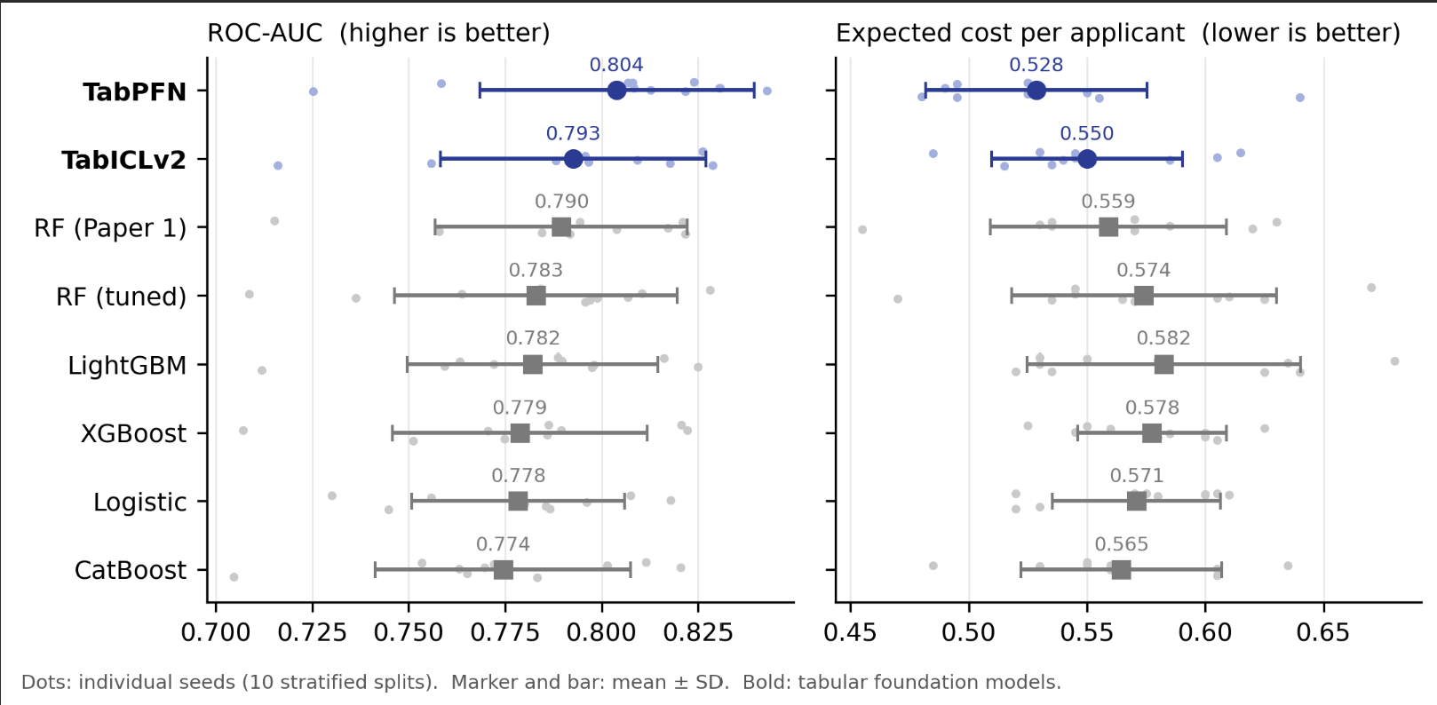
E1 in detail: every split, every model
What it shows
How to read it
Takeaway
ROC-AUC (left) and expected cost (right) for all 8 models over the 10 splits.
Small dots = one split each. Big marker = average; bar = spread (± SD). Blue = foundation models.
TabPFN is best on both, but the bars overlap a lot, so we need the paired test next.
Notes:
This chart shows every single split as a small dot. The spread from split to split is larger than the gap between models, because each test set has only 200 applicants. That is why the next slide compares models split by split.

Slide 17
E1: the paired test shows the gain is real for TabPFN
Comparison | Δ ROC-AUC | Splits better | p | Δ cost | Splits better | p
TabPFN − RF (Paper 1) | +0.014 | 10/10 | 0.002 | −0.031 | 8/10 | 0.041
TabPFN − RF (tuned) | +0.021 | 10/10 | 0.002 | −0.046 | 9/10 | 0.006
TabPFN − LightGBM | +0.022 | 9/10 | 0.004 | −0.054 | 9/10 | 0.004
TabICLv2 − RF (Paper 1) | +0.003 | 8/10 | 0.160 | −0.009 | 6/10 | 0.453
TabICLv2 − RF (tuned) | +0.010 | 7/10 | 0.105 | −0.024 | 8/10 | 0.131
TabICLv2 − LightGBM | +0.011 | 7/10 | 0.037 | −0.033 | 7/10 | 0.039
How to read it: each row compares two models on the same 10 splits. "Splits better" counts how often the foundation model won. p < 0.05 (in bold) means the difference is unlikely to be chance. TabPFN wins every comparison; TabICLv2 only clearly beats LightGBM.
Notes:
Because the spread across splits is bigger than the differences between models, we compare split by split. TabPFN beat the Paper 1 forest on all ten splits for ROC-AUC, with p equal to 0.002. TabICL is on par with Random Forest.

Slide 18
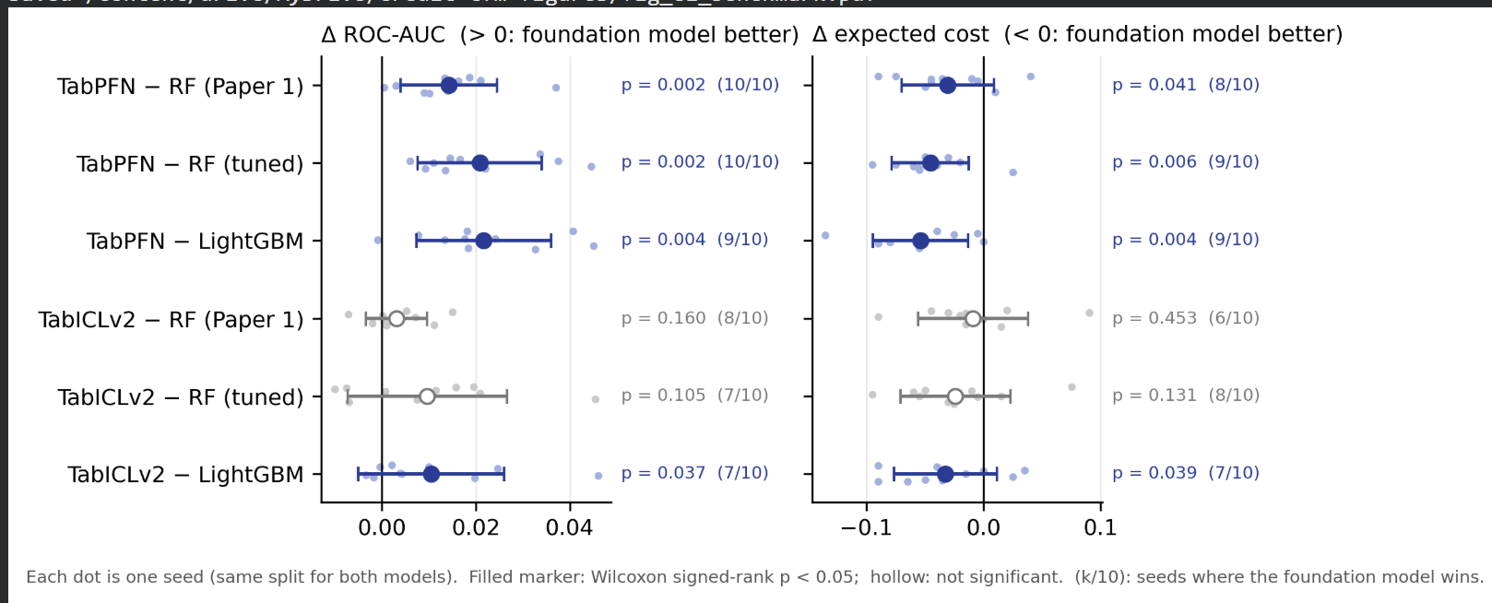
E1 paired differences, split by split
What it shows
How to read it
Takeaway
For each split: foundation model's score minus the baseline's score, on the same 200 test applicants.
Right of 0 (AUC) or left of 0 (cost) = foundation model better. Filled marker = significant (p < 0.05); hollow = not.
TabPFN wins clearly against all three baselines. TabICLv2 only clearly beats LightGBM.
Notes:
Because both models are tested on the same split, the split-to-split noise cancels out. TabPFN beats the Paper 1 forest in all ten splits for ROC-AUC. The numbers in brackets count wins; a tie is not counted as a win.

Slide 19
E2: conformal keeps its promise, but is not more accurate
≈ 0.90
coverage at α = 0.10 for every model (target 0.90)
0.205 vs 0.206
TabPFN error: conformal α = 0.20 vs fixed window, both ≈ 6–7% deferred
1 in 3
applicants sent to a human at 90% coverage
Notes:
Each dot is a deferral rule. Moving left means deferring more applicants, which lowers the error on the rest. The gold window points sit right on the same line as the conformal points, so at the same workload the two rules make about the same errors. What conformal adds is a guarantee and a clear knob, alpha. The cost of 90 percent coverage is high: about a third of applicants need a human.

Slide 20
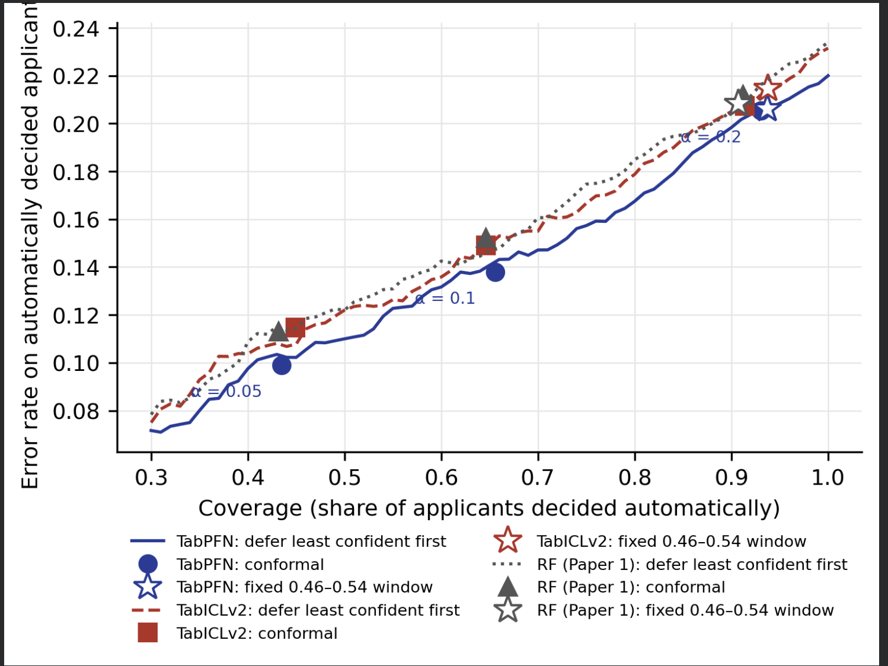
E2: the risk–coverage curve
What it shows
Error on automatic decisions as we let the model decide more applicants (left = more sent to humans).
How to read it
Lines: send the least confident applicants first. Shapes: conformal at α = 0.05, 0.10, 0.20. Stars: Paper 1's fixed window.
Takeaway
Conformal points and the window sit on the same curves: same errors at the same workload. Conformal adds a guarantee, not accuracy.
Notes:
Every line rises from left to right: the more applicants we decide automatically, the more mistakes. The conformal points and the stars of the fixed window lie on those same lines, so neither rule beats the other at equal workload. The blue TabPFN line is lowest, matching E1.

Slide 21
E3: applicants under 25 are deferred about twice as often
0.30
deferral gap for TabPFN (95% CI 0.25 – 0.37). Every interval, for every model and rule, stays above zero.
Group-wise conformal does not close the gap: it equalises coverage, not deferral
Foreign workers: only 65 in all test sets, too few to judge; group-wise conformal deferred 58% of them
Lenders should monitor who gets reviewed
Notes:
Young applicants are sent to a human about twice as often, with every model and every rule. The fixed window shows the same pattern; its numbers are just smaller because it defers less overall. Group-wise conformal makes coverage equal per group, not deferral. The foreign-worker group is too small to draw conclusions, and group-wise calibration breaks down for it.

Slide 22
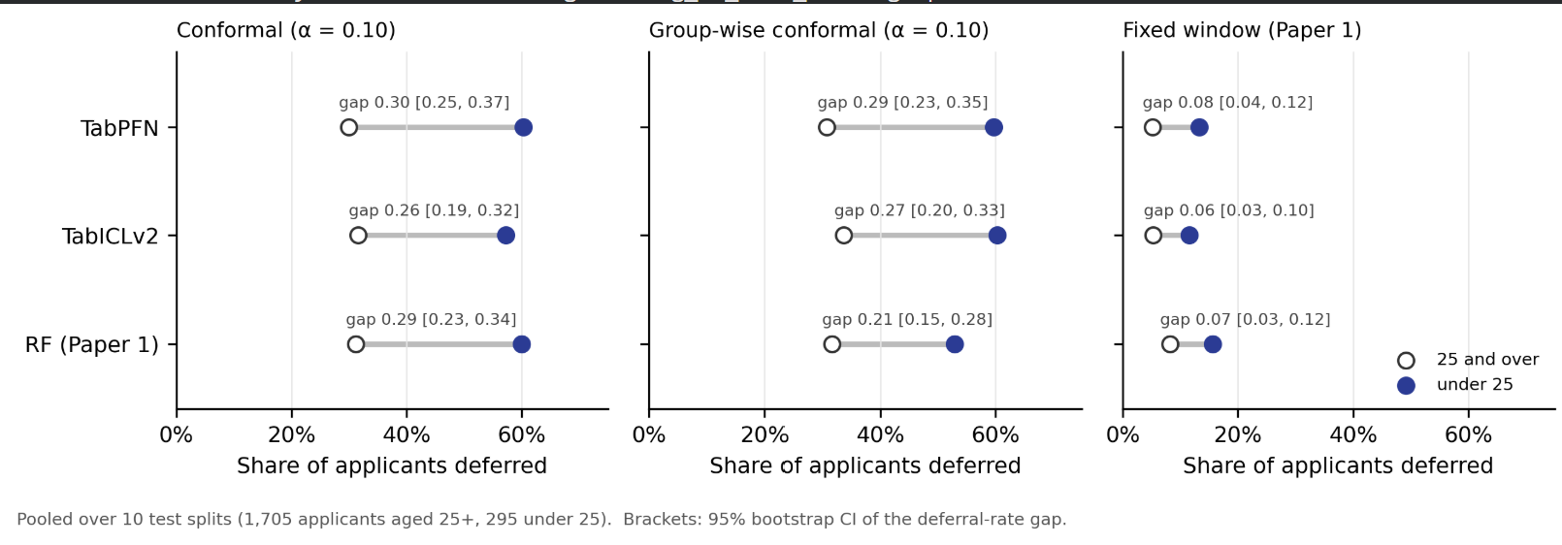
E3: the age gap, rule by rule
What it shows
How to read it
Takeaway
Share of applicants sent to a human, for under-25s (filled) and 25-and-over (open), for three models and three rules.
The longer the grey line, the bigger the gap. Brackets show the 95% confidence interval of the gap.
Under-25s are deferred about twice as often everywhere; no interval reaches zero. Group-wise conformal does not fix it.
Notes:
The gap appears for every model and every rule, so it comes from the data, not from one model. The fixed window has a smaller gap only because it defers fewer people overall; in ratio terms it is just as uneven.

Slide 23
E4: good explanations take 128–256 model runs
128 / 256
smallest budget reaching 0.9 agreement: TabICLv2 / TabPFN
38 s / 4 min
to explain ONE applicant alone on a T4 GPU (TabICLv2 / TabPFN)
0.45 s / 2.4 s
per applicant when 100 are explained together
Notes:
The reference is a careful explanation with 2,048 model runs. With only 32 runs, fewer than half of the top-3 reasons match it. TabICL needs 128 runs and TabPFN 256 to reach 90 percent agreement. That costs 38 seconds or about 4 minutes for one applicant on a T4 GPU, so truly real-time explanation is not possible with this method; batches work well, under 2.5 seconds per applicant. These are from seed 0; two more seeds will be added for the final paper.

Slide 24
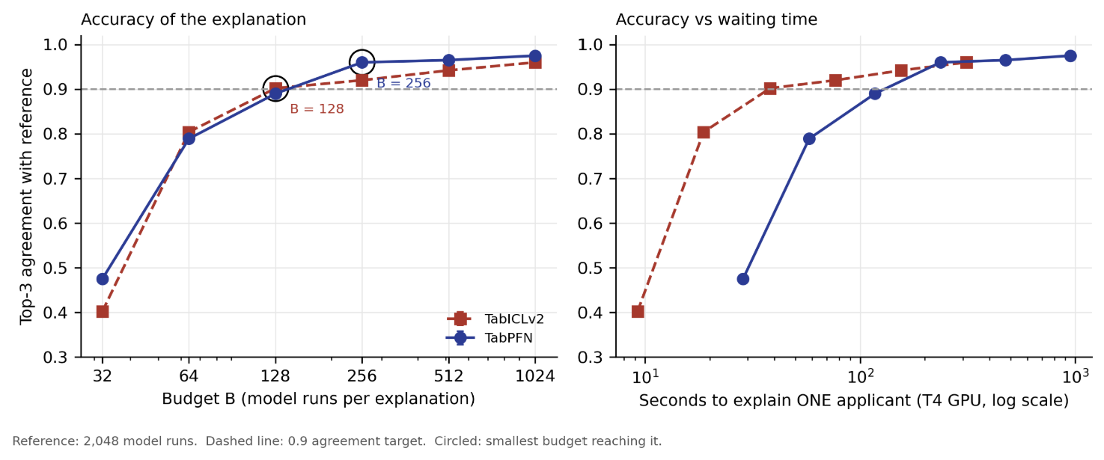
E4: accuracy against waiting time
What it shows
How to read it
Takeaway
Left: how closely the top-3 reasons match a careful 2,048-run reference as the budget grows. Right: the same, against seconds of waiting for one applicant.
Dashed line = 0.9 target; circles = the smallest budget that reaches it. The right panel uses a log scale (10 s, 100 s, 1,000 s).
TabICLv2 reaches 0.9 in about 40 s, TabPFN in about 4 min. Good explanations are a batch job, not an instant answer.
Notes:
The left panel answers how many model runs are enough. The right panel converts that into waiting time on a T4 GPU. TabICL is faster per run and needs fewer runs, so it reaches good explanations about six times faster than TabPFN.

Slide 25
E5: rejection reasons change when the context changes
≈ 0.5 vs 0.89
agreement at 600 rows vs the noise ceiling: about 2 of 3 reasons shared. The instability comes from the data, not the calculation
51–62%
of applicants get a different #1 reason across resamples (600 rows)
23–24% vs 33%
decisions that flip: foundation models vs retrained Random Forest (600 rows)
Notes:
This is the headline result. We resampled the context set five times and compared each applicant's top-3 rejection reasons. Even with the full 600 rows, two explanations share only about two of their three reasons, far below the 0.89 we get when we recompute with the same context, so the change is real. Stability grows with more data. At 600 rows the foundation models are as stable as a retrained Random Forest, slightly better for TabPFN, and their decisions flip less often: about 23 percent versus 33 percent.

Slide 26
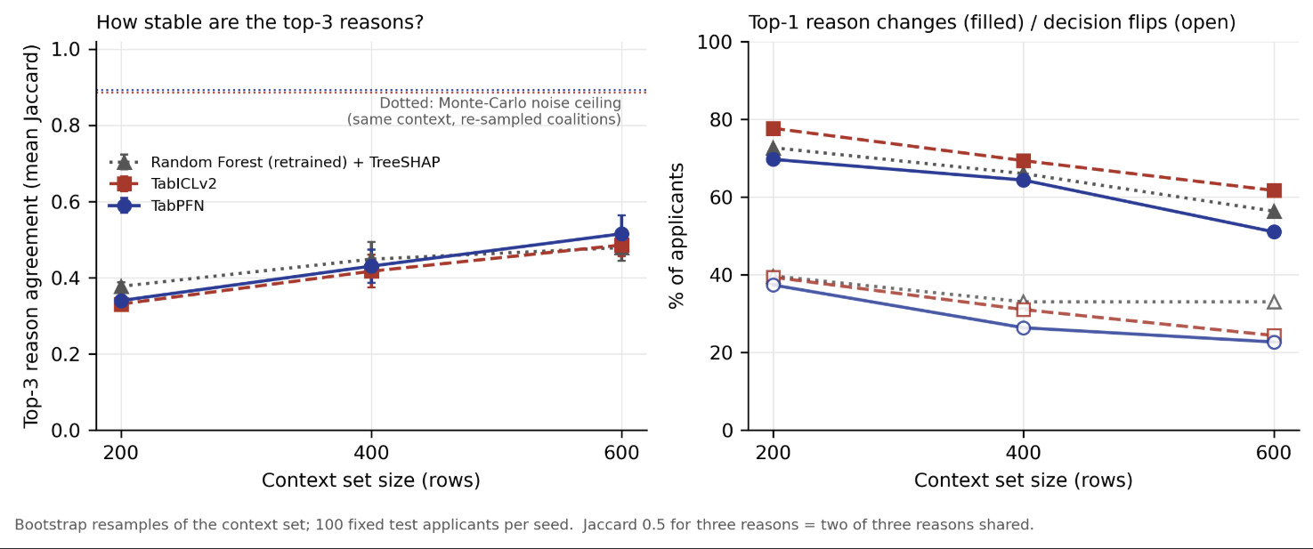
E5: stability chart (3 seeds)
What it shows
How to read it
Takeaway
Left: top-3 reason agreement as the context set grows. Right: % of applicants whose #1 reason changes (filled) and whose decision flips (open).
Dotted line at the top = how stable it would be if only random sampling mattered. The gap below it is caused by the context set.
All models stay far below the ceiling. More data helps, but at 600 rows about half of the applicants still get a different #1 reason.
Notes:
Error bars show the spread over three seeds. The foundation models start a little less stable than the Random Forest at 200 rows and catch up or overtake it at 600 rows. Decision flips fall to about a quarter for the foundation models but stay at a third for the Random Forest.

Slide 27
E5, realistic update: steadier, but #1 reason still moves
0.76–0.78
top-3 agreement when 90% of past applicants stay the same (vs ~0.5 under full bootstrap)
38–41% vs 24%
still get a different #1 reason: foundation models vs retrained Random Forest
10–11% vs 5%
decisions that flip: foundation models vs Random Forest
Notes:
The full bootstrap is a strong change, so we also tested a realistic one: each context keeps 90 percent of the past applicants, as if a bank replaced 10 percent. Agreement jumps to about 0.77, so the reasons are much steadier. But even then, the main reason changes for about 40 percent of applicants with the foundation models, compared with 24 percent for the Random Forest, and decisions flip twice as often. So the foundation models are a little less stable under small updates. This is from one seed only.

Slide 28
E5 worked examples: same applicant, different reasons
Applicant 562 (truly bad) · rejected in all 5 resamples
Applicant 738 (truly good) · wrongly rejected in all 5
Resample | P(bad) | Top-3 rejection reasons
1 | 0.84 | installment rate, duration, job
2 | 0.77 | personal status/sex, purpose, installment rate
3 | 0.75 | purpose, duration, savings
4 | 0.71 | purpose, status, age
5 | 0.79 | purpose, age, status
Resample | P(bad) | Top-3 rejection reasons
1 | 0.44 | purpose, installment rate, status
2 | 0.33 | purpose, status, credit history
3 | 0.21 | amount, property, telephone
4 | 0.37 | status, savings, installment rate
5 | 0.27 | status, property, installment rate
Same decision every time, but a protected attribute (sex/status or age) appears in the top-3 in some resamples only, so a fairness check would flag it or not by chance.
A good applicant is told a different main reason (purpose, status or amount) depending only on which past applicants the model saw.
Notes:
These are two real applicants from seed 0, explained by TabICL on five resampled context sets of 600 rows. For applicant 562 the decision never changes, but protected attributes move in and out of the top-3 reasons. For applicant 738, a good applicant who is wrongly rejected, the main reason given changes from loan purpose to account status to loan amount. This is why a stability gate is needed before reasons are shown to an applicant.

Slide 29
E6: uncertainty + stability gates work best together
U + S
recommended for both models (chosen on calibration). TabPFN cost 0.514 vs 0.570 with no gates; ~40% reviewed
53% vs 38–41%
error rate of applicants the stability gate flags vs the rest: unstable reasons are a warning sign
A ≈ no effect
attribution gate flags applicants with the same error as others; keep it as a compliance rule only
Notes:
We switched the three gates on and off in every combination. The uncertainty gate and the new stability gate together give the lowest cost on the decisions the system makes by itself, for both models. Applicants flagged by the stability gate were wrong 53 percent of the time against about 40 percent for the rest, so the gate catches risky cases. The attribution gate does not catch errors and even widens the age gap, because age is one of the protected features. The choice of U plus S assumes a human review costs half a unit; a different review cost could change it.

Slide 30
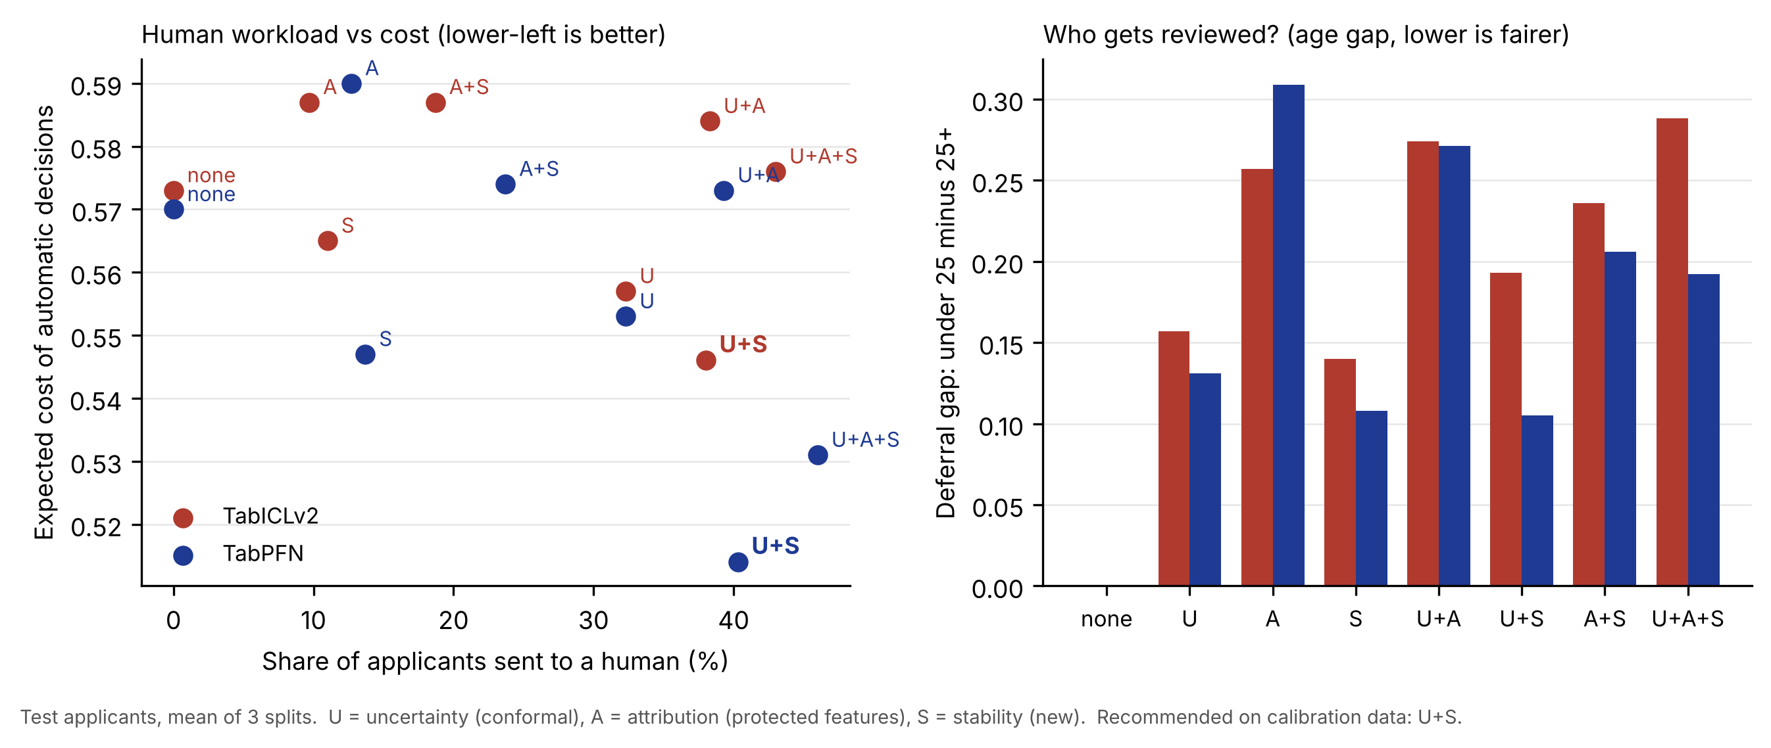
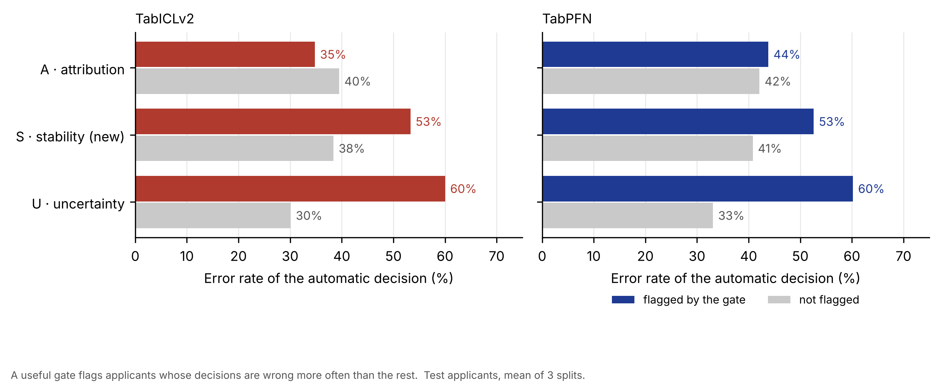
E6 charts: workload, fairness and catch rate
Top: workload vs cost
Each point is a gate setting. U+S (bold) sits lowest; anything with A raises cost and the age gap.
Bottom: catch rate
Coloured = applicants a gate flags, grey = the rest. U and S flag riskier decisions (60%, 53% wrong); A does not.
Takeaway
Keep U and S as risk gates; keep A only as a documented compliance rule.
Notes:
The top chart shows the trade-off between human workload and the cost of automatic decisions, plus the age gap. The bottom chart checks whether each gate flags the decisions that are more often wrong. The uncertainty and stability gates do; the attribution gate does not.

Slide 31
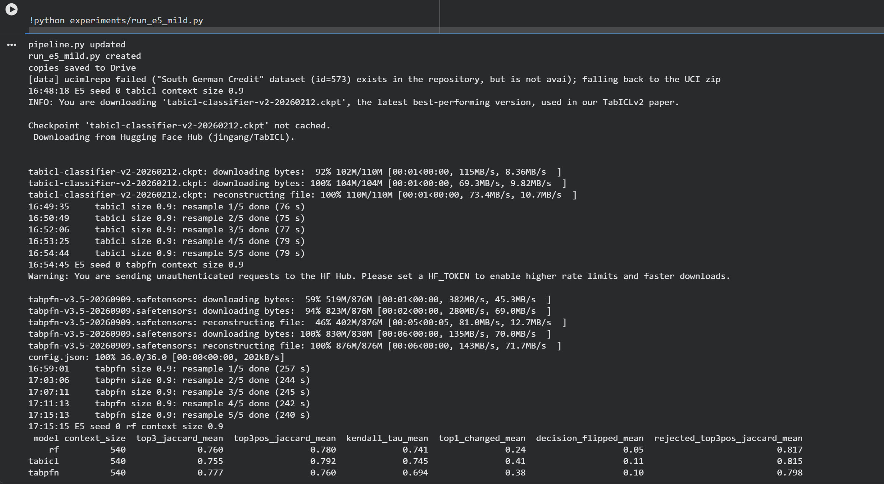
Evidence: Colab output for the milder E5 test
Each context keeps 90% of its 600 rows (540); seed 0, 5 resamples, budget 256
Notes:
Raw output of the milder E5 test.

Slide 32
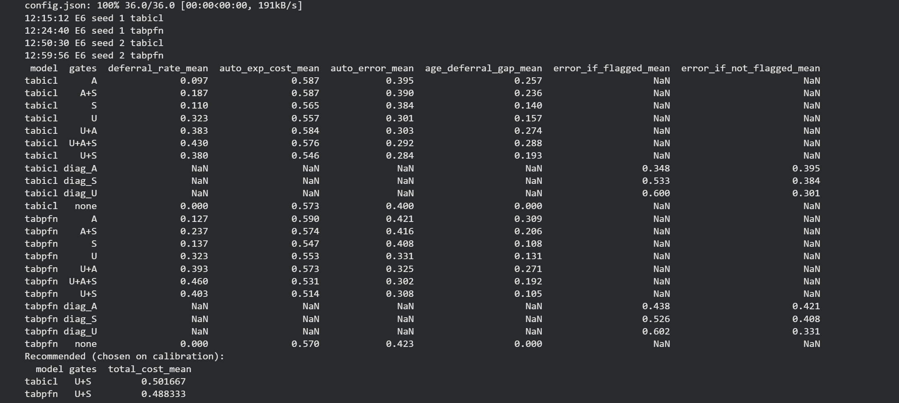
Evidence: Colab output for E6 (3 seeds)
Why so many NaN?
Gate rows (none, U, S, U+S …) fill deferral, cost, error and age gap.
Diagnostic rows (diag_U, diag_A, diag_S) fill only error_if_flagged / error_if_not_flagged.
NaN = "not applicable to this row", not missing data.
E6 gate ablation, mean over seeds 0–2
Notes:
Raw E6 output. The NaN cells only mean that a column does not apply to that kind of row.

Slide 33
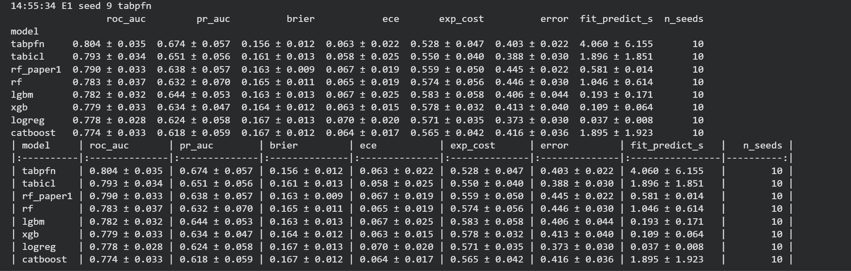
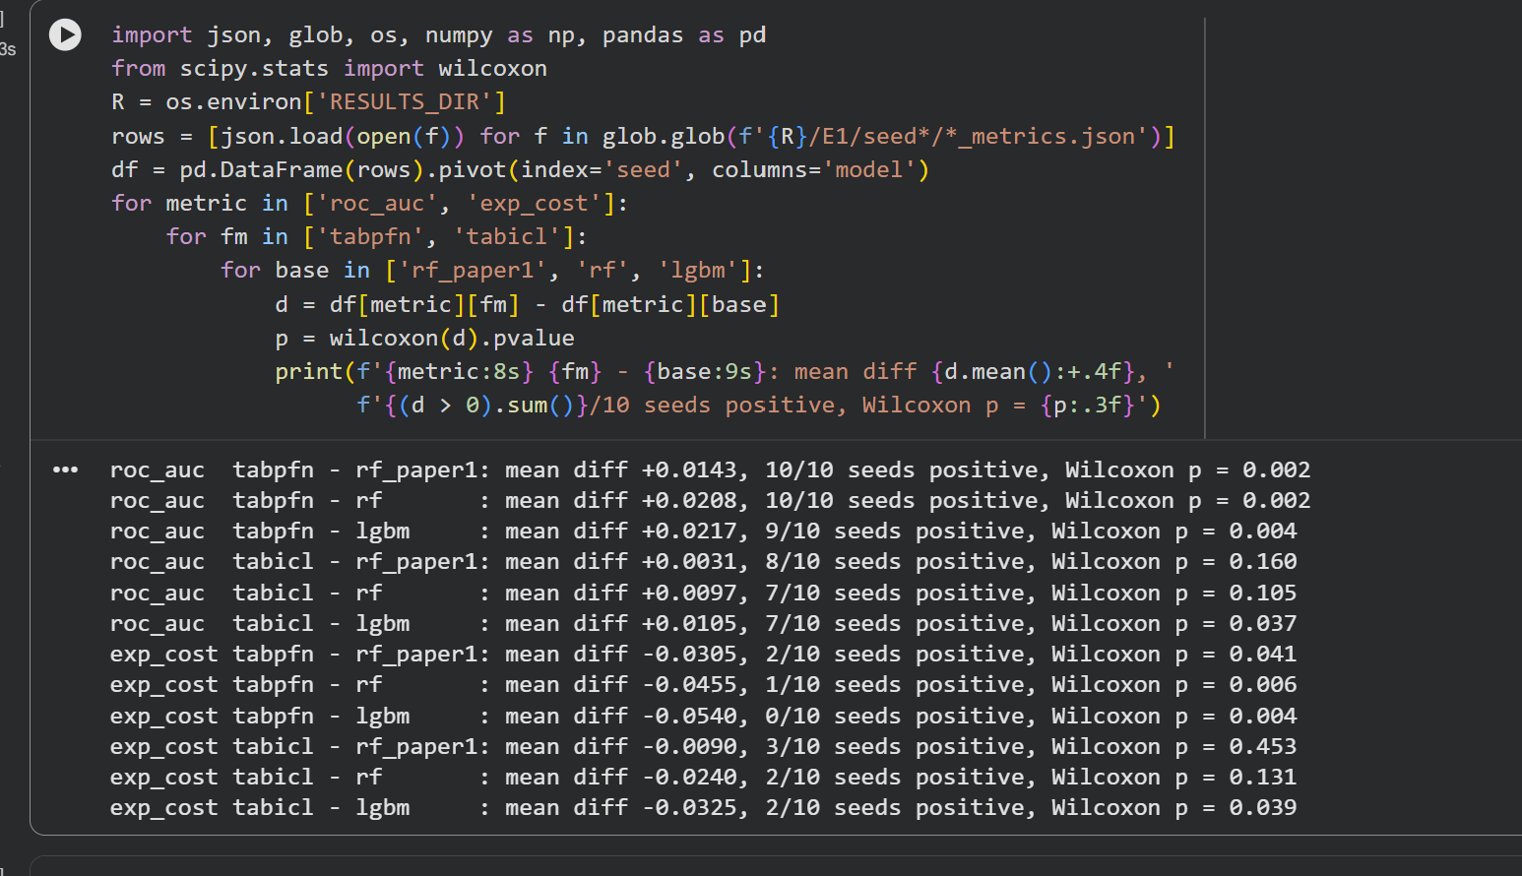
Evidence: Colab outputs for E1
E1 summary over 10 seeds: all 8 models
Where the numbers come from
Every number in this deck is copied from these saved Colab outputs. All models used the same 10 splits (seeds 0–9), so results can be compared split by split.
Paired Wilcoxon tests
Notes:
These are the original Colab outputs, kept as evidence.

Slide 34
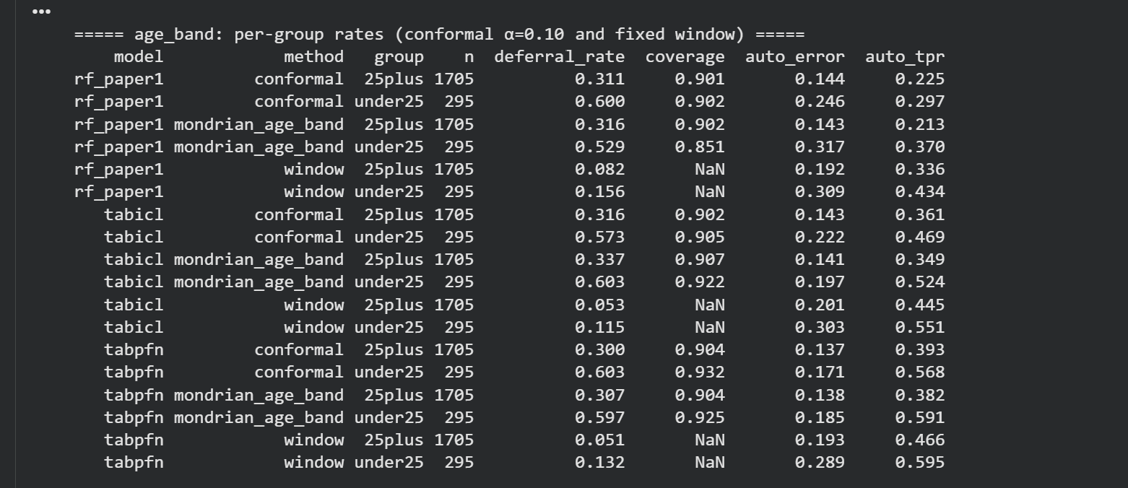
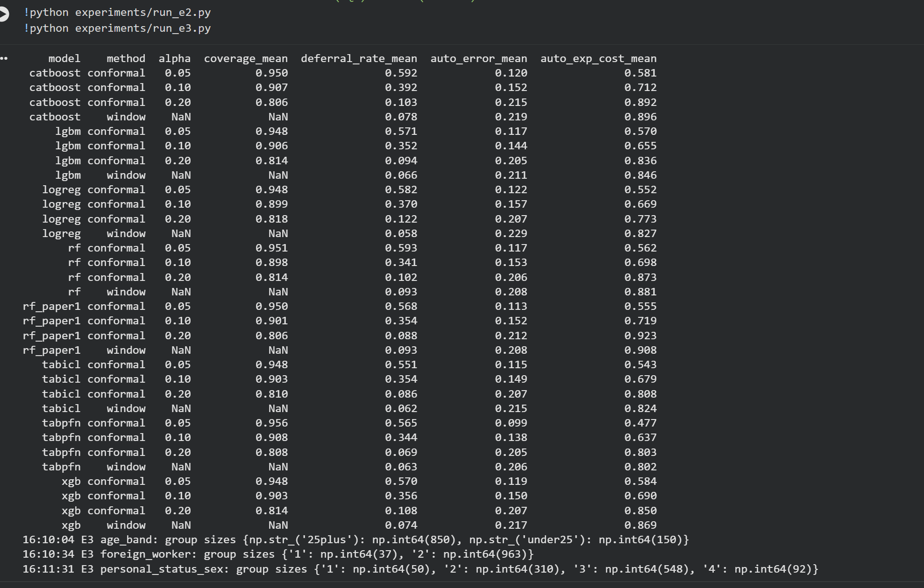
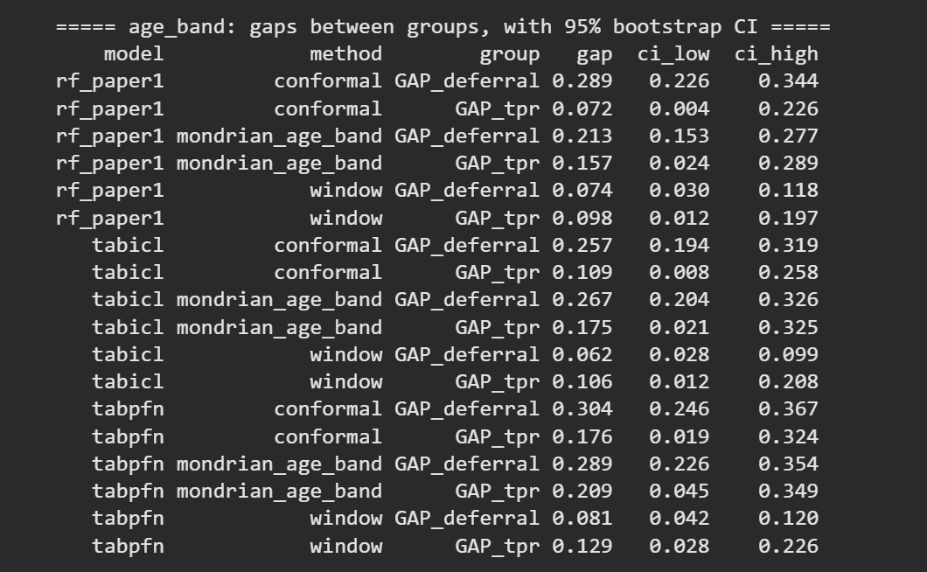
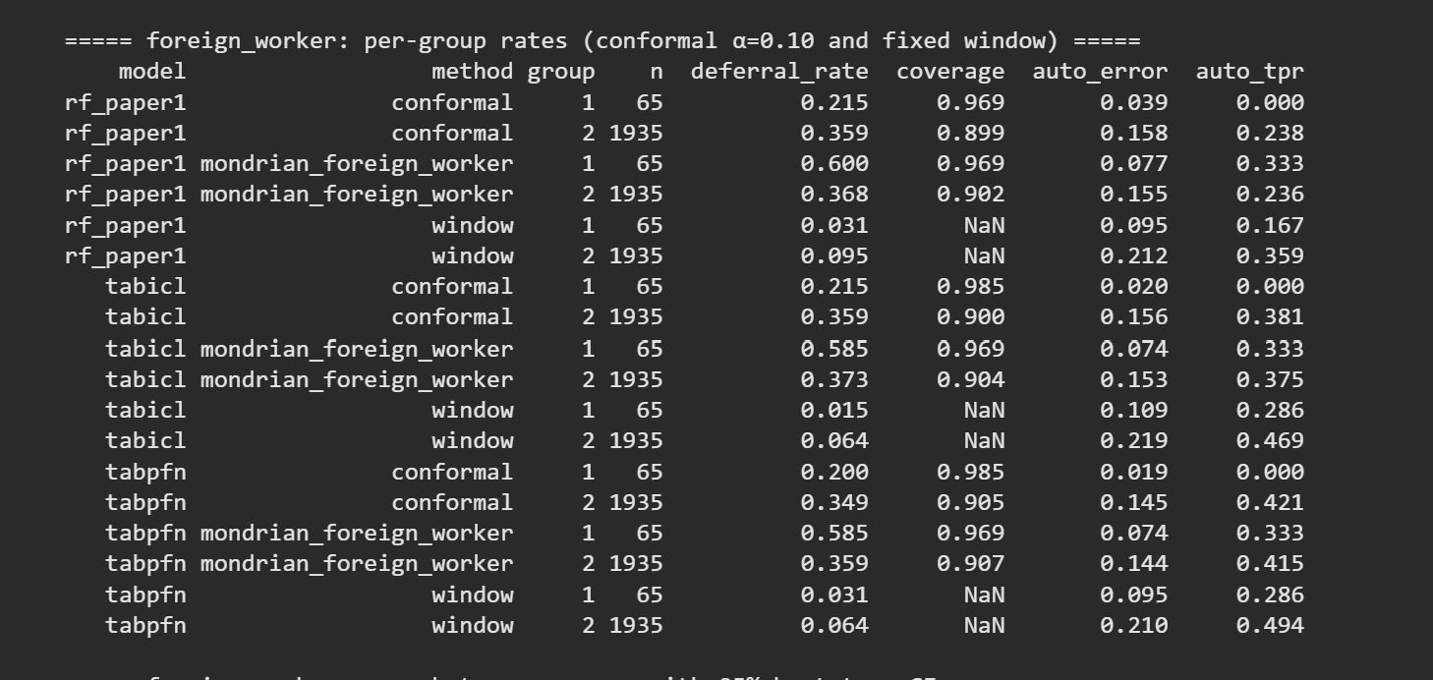
Evidence: Colab outputs for E2 and E3
E2: coverage, deferral and error for all models
E3: rates and gaps by age band and foreign-worker status
Notes:
Raw outputs for E2 and E3.

Slide 35
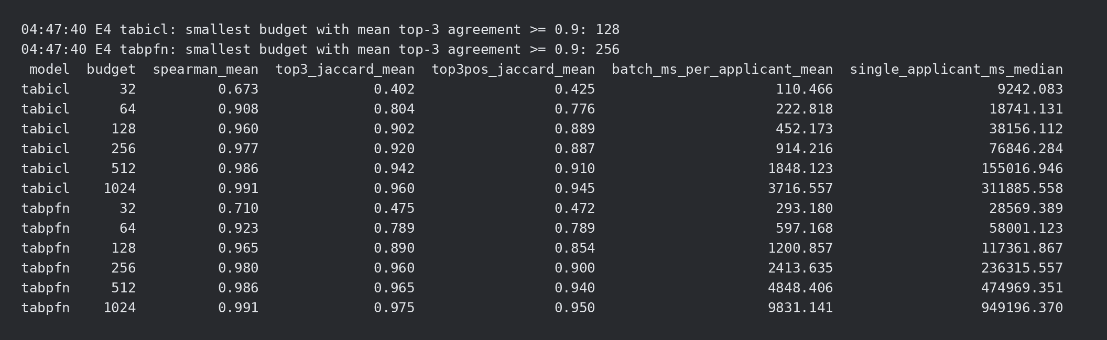
Evidence: Colab output for E4
E4 summary, seed 0 (columns of standard deviations are empty for a single seed and are not shown)
top3_jaccard = agreement of the top-3 reasons with the 2,048-run reference; batch_ms = time per applicant when 100 are explained together; single_applicant_ms = time for one applicant alone.
Notes:
Raw E4 output for seed 0.

Slide 36
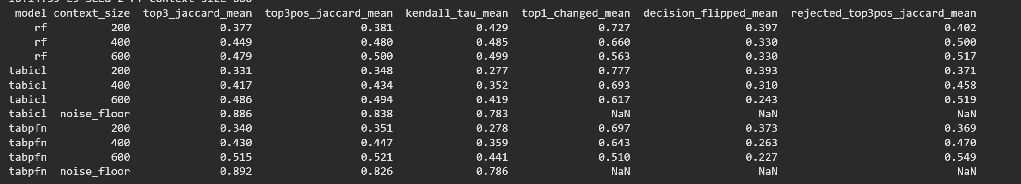
Evidence: Colab output for E5 (3 seeds)
E5 summary, mean over seeds 0, 1, 2 (budget 256, 5 bootstrap resamples per context size)
top3_jaccard = agreement of the top-3 reasons between resamples; kendall_tau = agreement of the full ranking; top1_changed = share whose #1 reason changes; decision_flipped = share whose approve/reject decision changes; noise_floor = same context, re-sampled coalitions.
Notes:
Raw E5 output averaged over three seeds.

Slide 37
Key findings
1
TabPFN predicts better
Higher ROC-AUC on all 10 splits (0.804 vs 0.790, p = 0.002) and about 6% lower expected cost. TabICLv2 is on par with Random Forest.
2
Conformal = guarantee, not accuracy
Coverage is always met, but at the same workload it makes the same errors as the fixed window. Its value is a provable, tunable safety level.
3
Deferral is unequal
Under-25s are sent to a human about twice as often under every model and rule. Small groups (foreign workers) cannot be judged.
4
Good explanations are not instant
128–256 model runs give ≥ 0.9 agreement, but that takes 38 s (TabICLv2) to 4 min (TabPFN) for one applicant; batches cost under 2.5 s each.
5
Rejection reasons are not stable (headline)
Agreement ≈ 0.5 (full bootstrap) to 0.77 (realistic update) vs a 0.89 ceiling; #1 reason still changes for ~40%.
6
The stability gate earns its place
Flagged applicants are wrong 53% vs 38–41%; U + S gives the lowest cost on automatic decisions for both models.
Notes:
Six findings; the sixth shows the full system works. The fifth is the headline: rejection reasons change substantially when the context set changes, for every model. Earlier findings: TabPFN is genuinely better, conformal deferral gives a guarantee rather than higher accuracy, the human workload falls unevenly on young applicants, and high-quality explanations of these models take seconds to minutes, not milliseconds.

Slide 38
What it means, and where the limits are
For lenders
For regulators
Limitations
Use the foundation model to score, but check a reason's stability before sending it
Give the decision now, the explanation later (batch)
Report the age mix of reviewed cases
EU AI Act: credit scoring is high-risk (Annex III 5(b)); Tier 3 implements Art. 14 human oversight
Art. 86 explanations should be stability-checked
RBI FREE-AI (Aug 2025): fairness, accountability, explainability, auditable thresholds
1973–75 data from one German bank
Small groups (37 foreign workers); sex not recoverable
E4–E6 on 1–3 splits; T4 timings; review cost assumed
TabPFN weights non-commercial licence
Bottom line: rejection reasons from small-data credit models should be treated as something to verify, not a fixed fact; the stability gate does that check.
Notes:
For lenders, the main lesson is to treat a rejection reason as something to verify, not a fixed fact. For regulators, our three gates map onto the EU AI Act's human-oversight requirement for high-risk credit scoring and onto the fairness and accountability themes of RBI's FREE-AI framework. The main limitations are the old single-country data, small groups, fewer splits for the expensive experiments, and TabPFN's non-commercial licence.

Slide 39
How the results were verified
✓
Code
✓
Experiment design
✓
Results
Shapley code = brute-force exact values (difference 0.0)
Nested budgets = separate runs (difference 0.0)
Conformal coverage on 200 simulated datasets: 0.90 (target 0.90)
Full pipeline tested on synthetic data first
Same saved splits for every model (seeds 0–9)
Tuning only on the context set; thresholds only on calibration
No leakage: best AUC 0.804, below the 0.85 warning level
Trees fairly tuned (Optuna, 50 trials)
Paired Wilcoxon tests; bootstrap 95% CIs
Coverage within 2 points of 1 − α for all models
Noise ceiling 0.89 shows instability is real; holds under a milder 90% update
Every number copied from saved Colab outputs
Still to check before submission: references [3] and [8] and the EU AI Act wording against official sources; record package versions.
Notes:
These checks are why the numbers can be trusted. The maths was tested against exact answers, the design avoids tuning on test data, and every comparison uses paired tests or confidence intervals. A few references still need to be checked against their official sources.

Slide 40
Future work
E4+
More splits
Repeat E4 (and extend E5, E6) on more splits so every result has error bars
E5+
Gradual updates over time
Repeat the 90% update on more seeds, and with time-ordered updates (add newest applicants, drop oldest)
E7
Larger, newer data
Taiwan credit-card default at 1k, 5k and 10k rows
→
Cost-aware and faster
A conformal score that uses the 5:1 cost matrix; caching so stable explanations arrive while the applicant waits
Notes:
All six experiments are complete. Future work adds more splits, a milder resampling for E5, a larger dataset, and a cost-aware, faster version of the system.

Slide 41
Thank you
Questions and feedback welcome

